Slide 2
Objectives
To identify floral design tools.
To describe the use of adhesives in floral designs.
To discuss different products necessary to floral design.

Slide 3
Main Menu
Knives & Scissors
Wire Cutters
Florist/Pruning Shears
Stem Strippers
Adhesives
Water Tubes
Waterproof Clay
Floral Foam
Candle & Anchor Pins
Floral Care & Handling
Ribbons
Wires
Containers
Corsage & Boutonniere Accessories

Slide 4
4

Slide 5
Floral Knives
Are available in several different styles
Cut flower stems
Need to have a sharp blade for most efficient use

Slide 6
Folding Knives
Are commonly used by florists for convenience
Fold up safely when not in use
Can be found with a straight or hooked blade

Slide 7
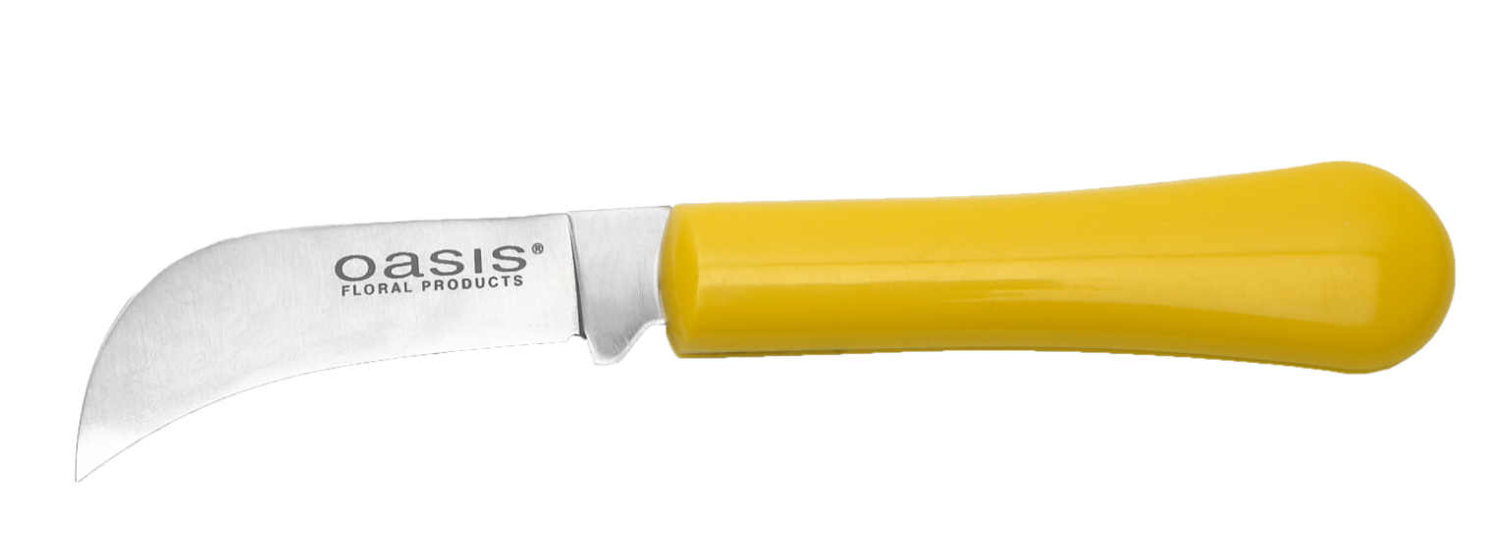
Folding Knives
Are the most common knives used to cut stems
Typically are inexpensive

Slide 8
Floral Foam Knives
Are used to cut foam bricks to desired sizes
Have an extra long blade for ease of use

Slide 9
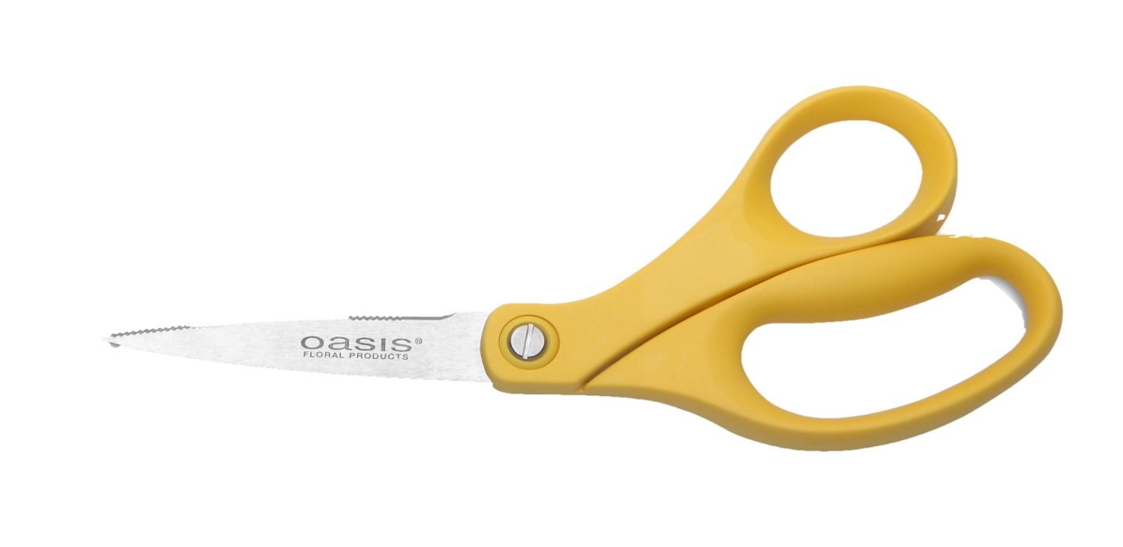
Floral Scissors
Are used to cut ribbon and wire
With serrated edges should only be used to cut wire
Have a long, slender blade
Are only used to fix ribbon, fine netting and fabric

Slide 10
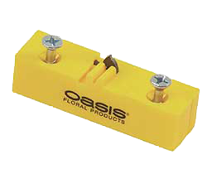
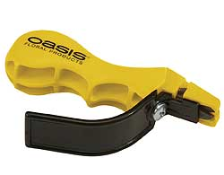
Blade Sharpeners
Are used to keep scissor and knife blades sharp

Slide 11
11

Slide 12
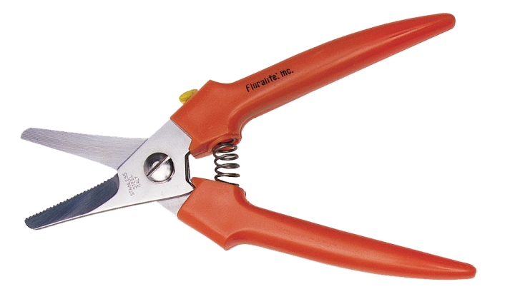
Wire Snips
Have a spring action handle with short blades
Are used to cut heavy duty wire, corsage and boutonniere stems

Slide 13
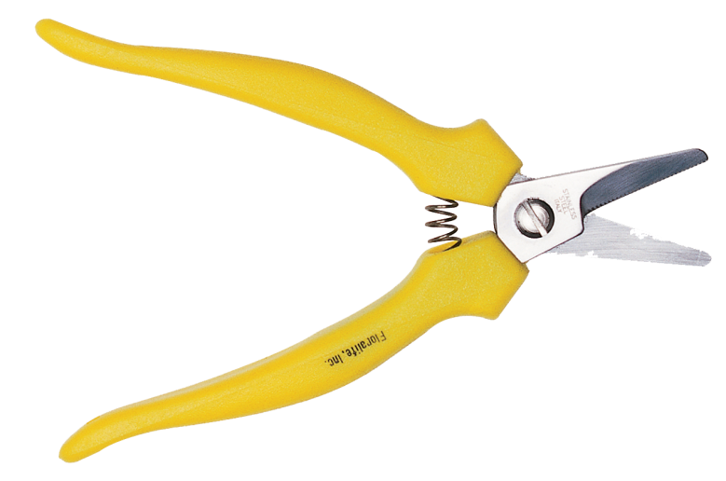
Utility Wire Cutters
Have longer blades with serrated edges
Cut floral wire, plastic and chicken wire with ease

Slide 14
Return to
Main Menu

Slide 15
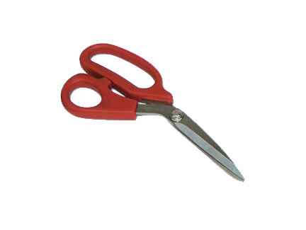
Floral Shears
Are designed to cut stems without crushing them
Have a cutting action in both directions of the blade
Are used to cut thick or woody stems

Slide 16
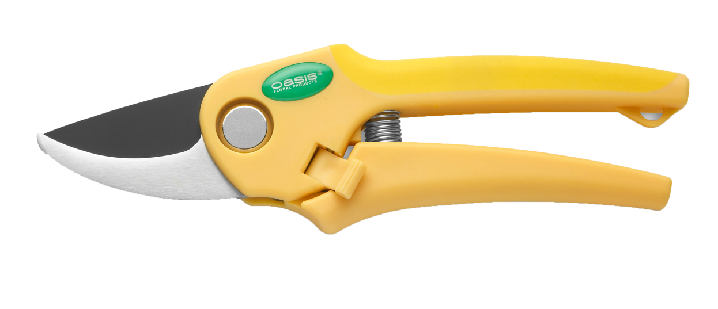
Pruning Shears
Cut very thick or tough branches with one smooth cut
Should always have sharp cutting blades

Slide 17
17

Slide 18
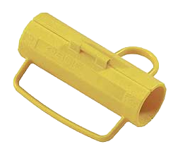
Stem Strippers
Are used to remove thorns and leaves from stems
Need to be used carefully to prevent stripping tender bark from stems

Slide 20
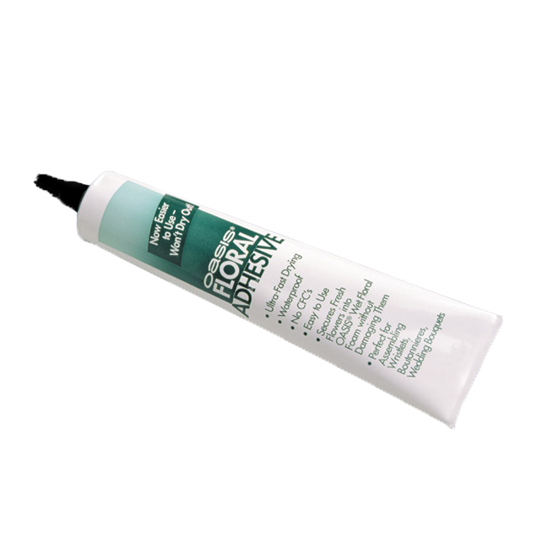
Floral Adhesives
Are fast-drying and waterproof
Bond quickly, safely and easily
Are used with fresh flowers
Provide a more time efficient approach to adhering flowers as opposed to glues

Slide 21
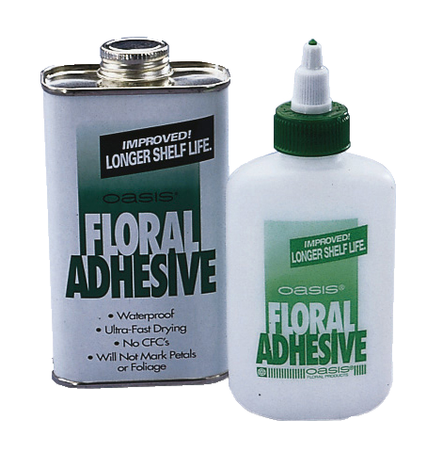
Floral Adhesives
Will not brown fresh flower petals
Maintain bonds in cold temperatures
Are also available in sprays and tapes for use with:
glitter
ribbon,
fabric
fashion gems and stones

Slide 22
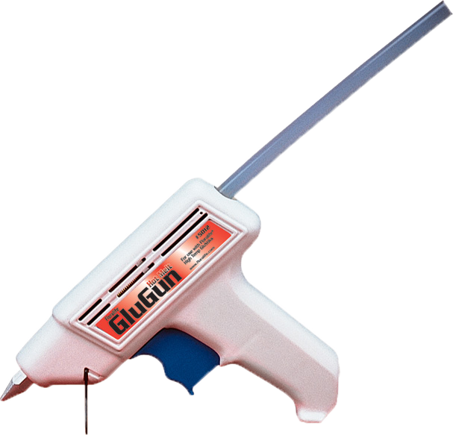
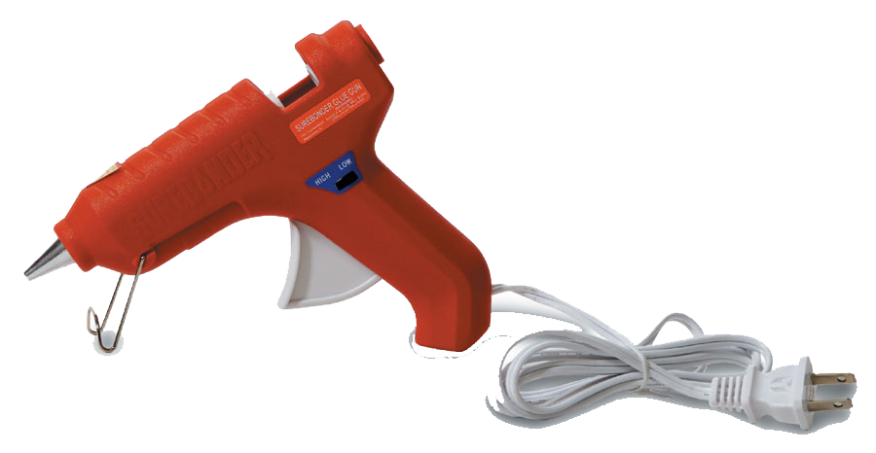
Glue Guns
Are available in high and low temperature styles
Range in use sensitivity due to different temperatures

Slide 23
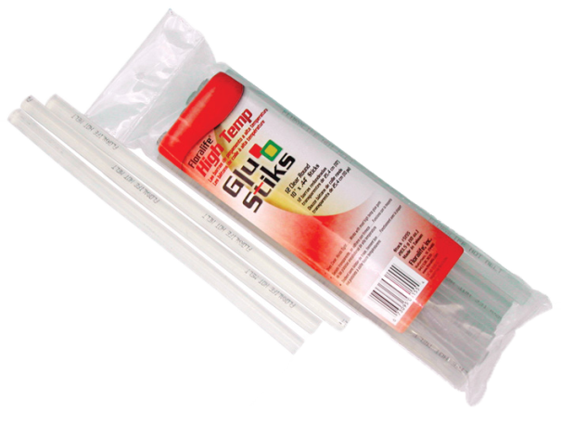
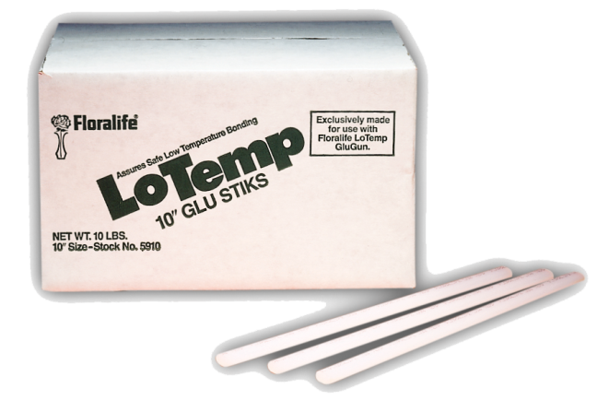
Glue Guns
Glue sticks are available in two common sizes
1/4 in. diameter
1/2 in. diameter
TIP: Use caution when using electric glue guns – tips and glue are extremely hot and can cause severe burns.

Slide 24
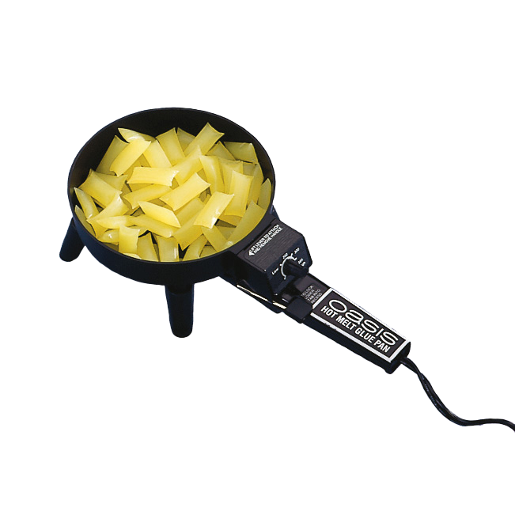
Pan Melt Glue
Uses a small electric pan, or glue skillet to melt small pellets, chips or blocks of glue
Is melted to a molasses consistency in order for the materials to be dipped into the glue

Slide 25
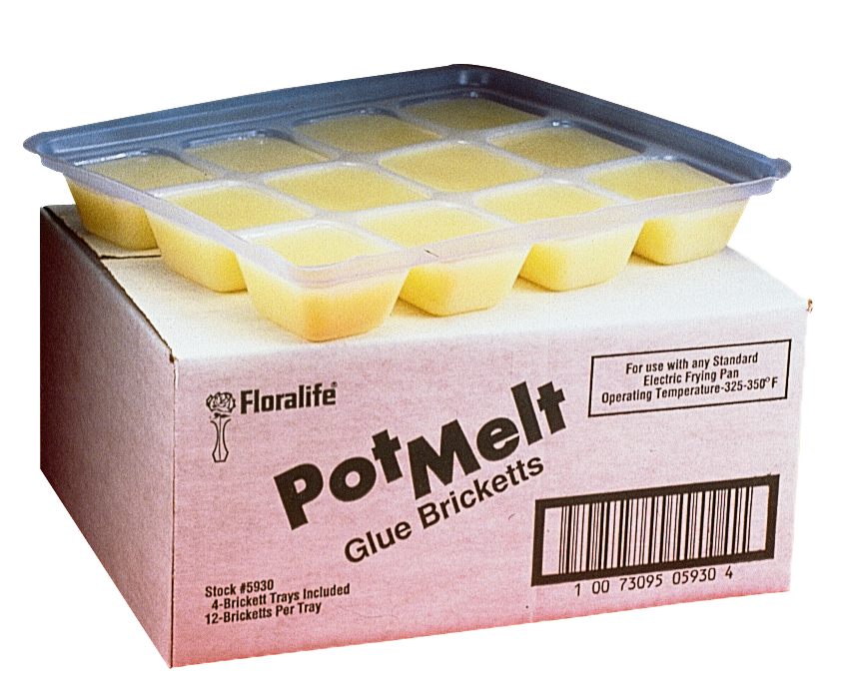
Pan Melt Glue
Is not affected by moisture and temperature like other glues
Can be stored by cooling down the glue until it hardens
Can be reheated for quick use

Slide 26
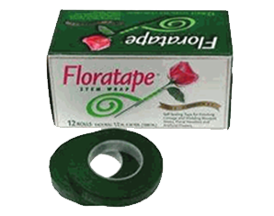
Floral Stem Tape
Is durable, stretchable tape that adheres to itself
Can be used to lengthen and strengthen stems
Is used to create:
corsages
bouquets
headpieces
nosegays
boutonnieres

Slide 27
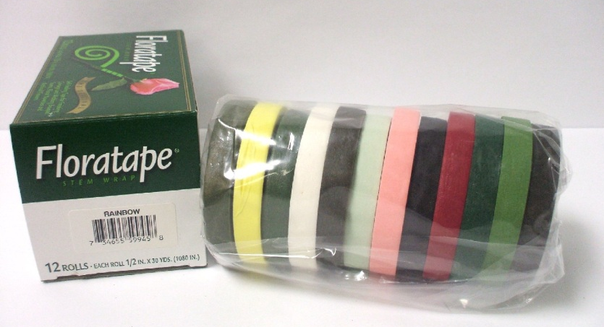
Floral Stem Tape
Adhesive material is activated only when tape is stretched
Is stretched as it is wrapped around fresh, dried or silk flower stems
Comes in a variety of colors

Slide 28
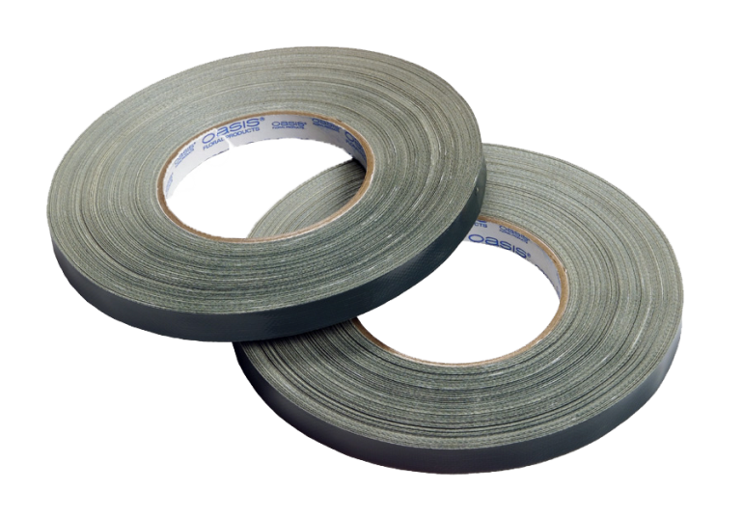
Anchor Tape
Is also known as waterproof tape
Is an all-purpose product for holding either wet or dried foam in place

Slide 29
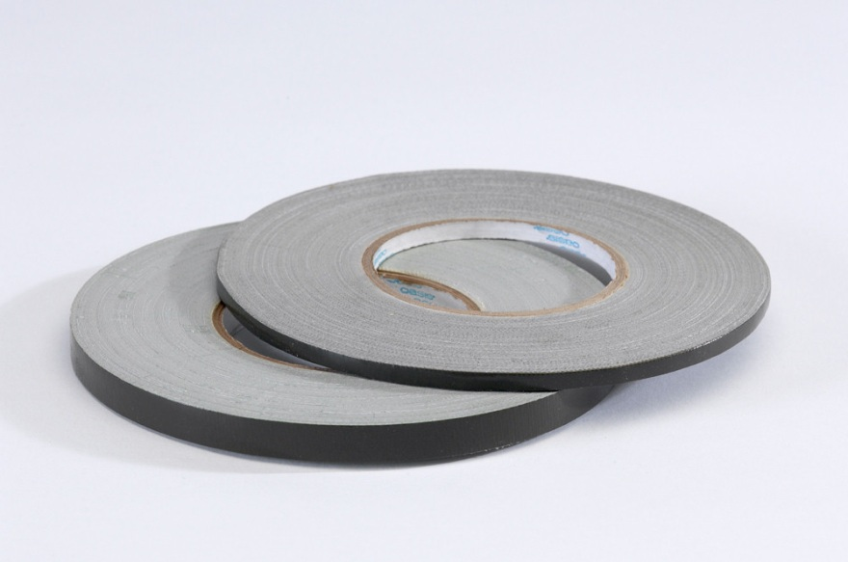
Anchor Tape
Comes in two colors: white and green
Is waterproof and pressure sensitive
repels water and sticks to a surface or object when force is applied to it

Slide 30
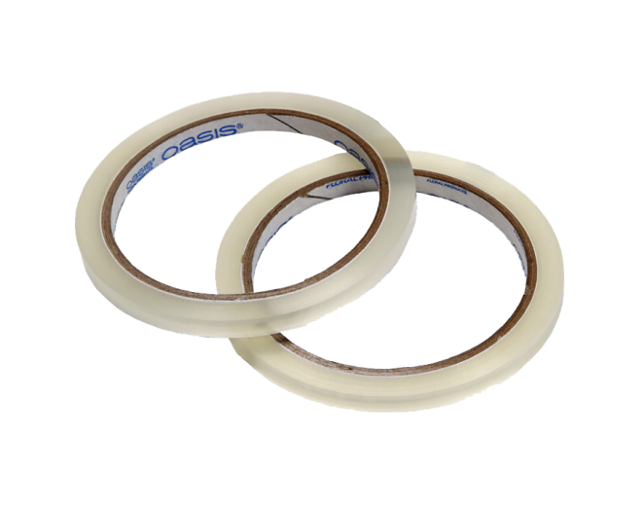
Clear Tape
Adheres to a dry surface and remains firm, in place even when exposed to moisture
Sticks on pottery, metal, plastic, wood, glass, ceramics, etc.
Is used to make grids for flowers in vases

Slide 31
31
Return to
Main Menu

Slide 32
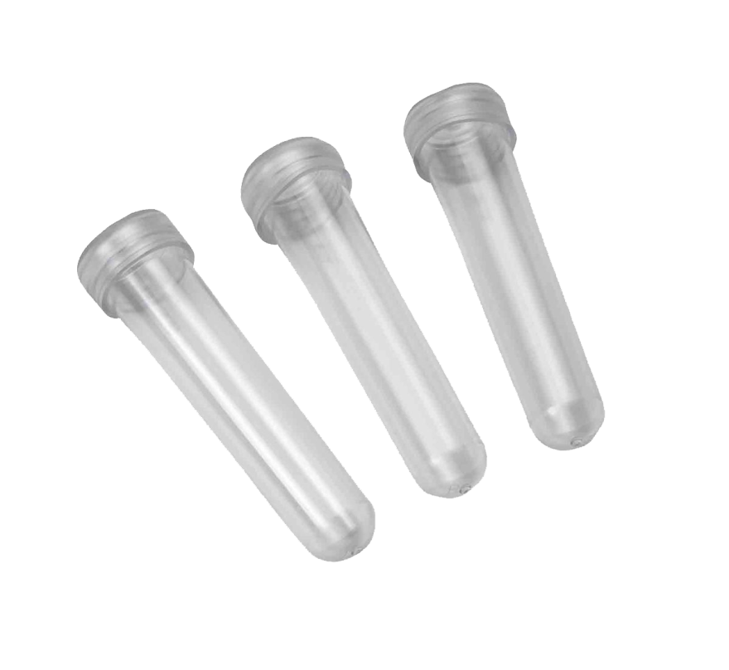
Water Tubes
Are clear plastic tubes with tight fitting clear cap
Are ideal for boxed flowers

Slide 33
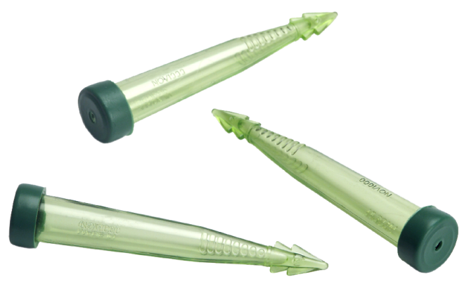
Water Picks
Are green plastic tubes with a cap
Can be inserted into foam with ease

Slide 34
Return to
Main Menu
34

Slide 35
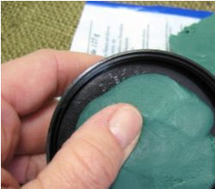
Waterproof Clay
Is waterproof and heat proof
Can assist in positioning and holding several elements of the arrangement such as:
candles
figurines
TIP: Make sure the surface is absolutely dry and free of dust or the clay will not stick.

Slide 36
36
Return to
Main Menu

Slide 37
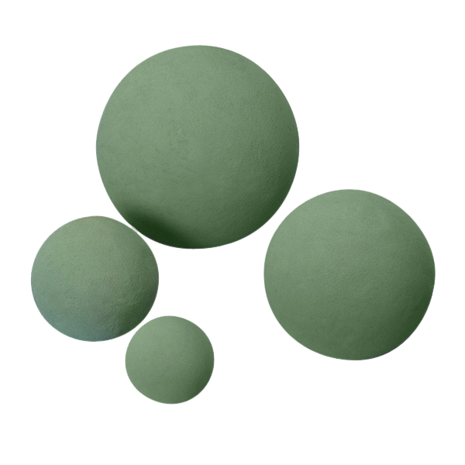
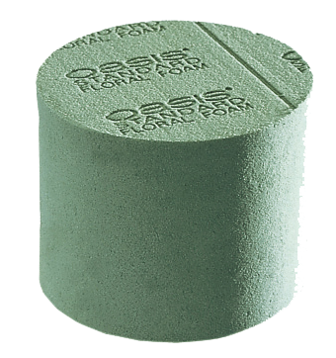
Floral Foam
Is used as a stem support device
Allows flowers to better absorb water and nutrients, resulting in a longer shelf life
Should be soaked in water or preservative solution before use

Slide 38
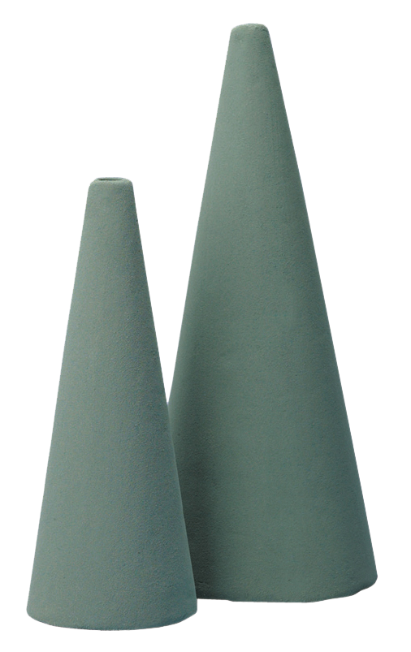
Floral Foam
Is available in various types, shapes, styles, textures and sizes
Can be cut with a serrated knife or florist knife to fit the size of the container

Slide 39
39
Return to
Main Menu

Slide 40
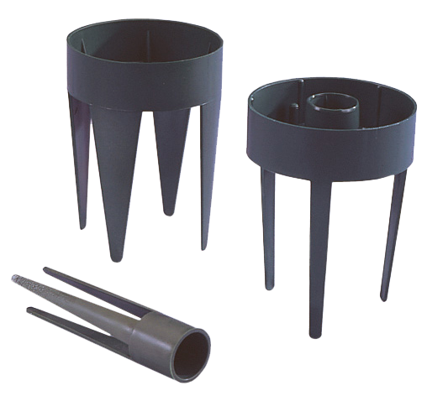
Candle Cups
Are small, inexpensive containers designed to hold taper candles in floral foam
Become a necessity when making centerpiece arrangements with taper candles
Combined with the use of floral clay help secure positioning of the candles

Slide 41
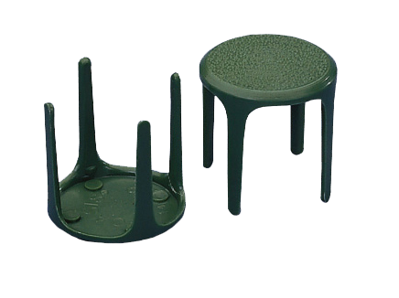
Anchor Pins
Are also known as foam prongs
Secure floral foam firmly to the bottom of a vase
Are applied to the bottom of the vase with hot glue or waterproof clay, then the floral foam is pressed onto the pins of the prong

Slide 42
Return to
Main Menu

Slide 43
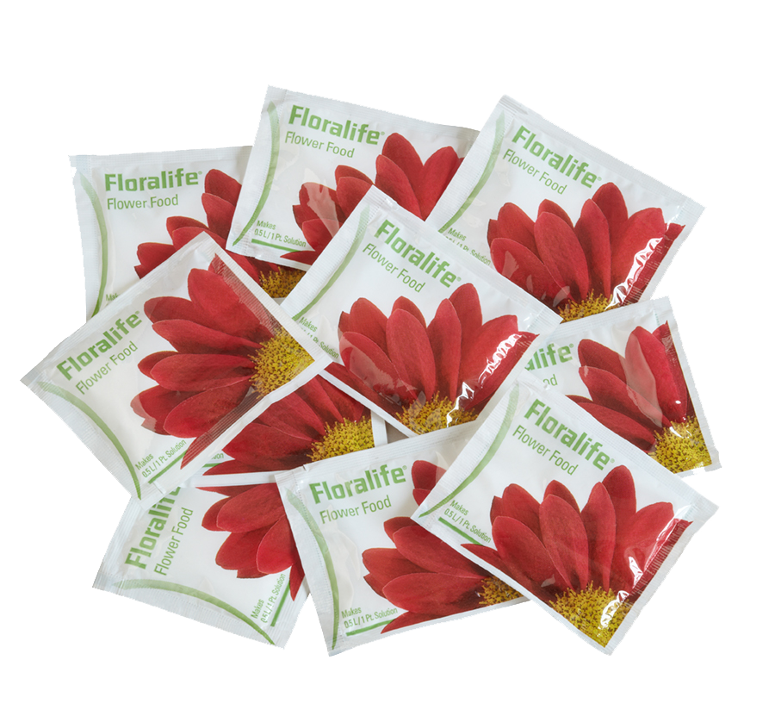
Floral Preservatives
Are used to extend the shelf life of fresh flowers by:
replenishing the food source
lowering the pH
reducing bacterial growth
Created commercially are the best product for fresh cut flowers

Slide 44
Leaf Shine
Is used to clean and shine leaves
Causes a natural luster on the leaf without having to wipe the leaf
Helps prevent pests and fungus on plants

Slide 45
Leaf Shine
Will not restrict photosynthesis
Does not contain fluorocarbons
Fluorocarbons: molecules composed wholly of carbon and fluorine

Slide 46
Return to
Main Menu

Slide 47
Ribbon
Is typically sold in either 40 or 100 yard rolls
Comes in many different widths
common sizes include 1,3,5,9 and 40
The smaller the number, the more narrow the ribbon is – the larger the number, the wider the ribbon.

Slide 48
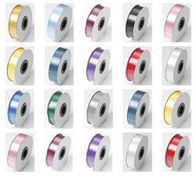
Ribbon
Comes in many different materials which include:
satin
nylon
fabric
plastic
sheer (transparent)
tulle

Slide 49
49
Return to
Main Menu

Slide 50
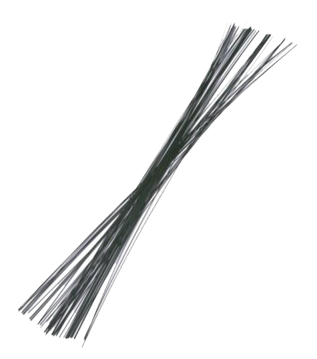
Floral Wire
Can be used to lengthen and strengthen stems
Is used in making corsages, flower arranging, wreath and swag hangers

Slide 51
Floral Wire
Helps make professional ribbon bows
Is available in many different sizes including 20, 22, 24 , 26 and 30 gauge (diameter)

Slide 52
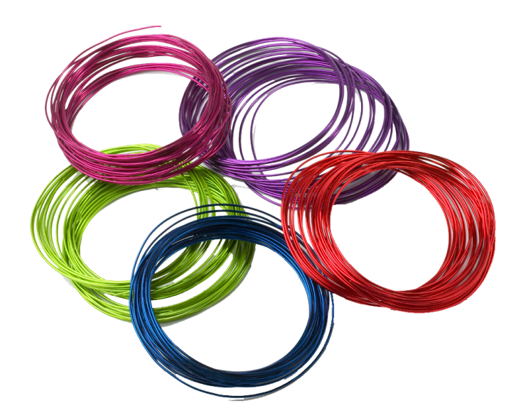
Aluminum Wire
Is strong, malleable wire which is easy to shape
Is available in 12, 20, 22, 24, 26 and 30 gauge wire
Adds impact to structures such as a base for corsages

Slide 53
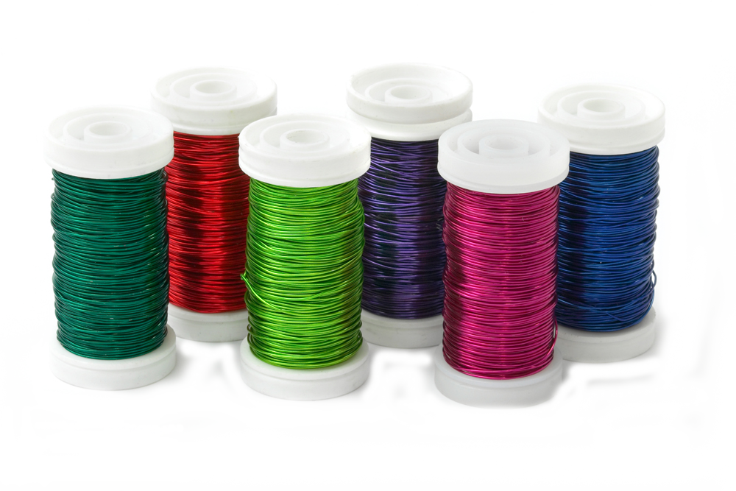
Aluminum Wire
Can be used to stabilize arrangements
Is available in twelve colors
gold, silver, purple, lime green, pink, copper, blue, red, strong pink, black, turquoise and brown

Slide 54
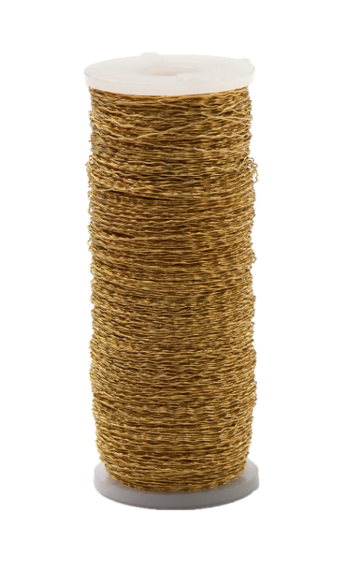
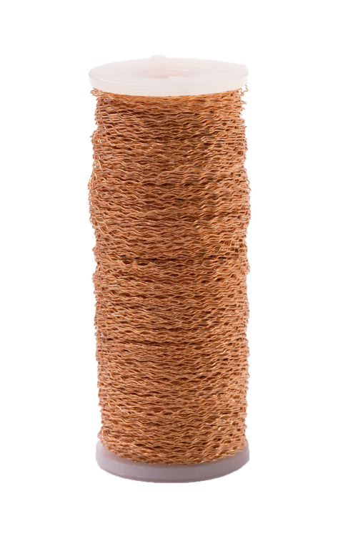
Bullion Wire
Is most commonly available in 28 gauge
Adds sparkle and shine to bouquets and arrangements
Is also a great tool for wrapping stems to add a colorful flair

Slide 55
55
Return to
Main Menu

Slide 56
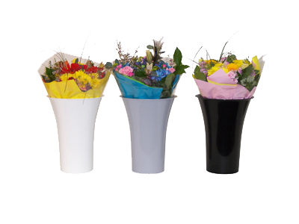
Storage Containers
Could include a wet pack container for flowers with longer stems
Can be used for smaller amounts of flowers
Are used to display flowers in floral coolers

Slide 57
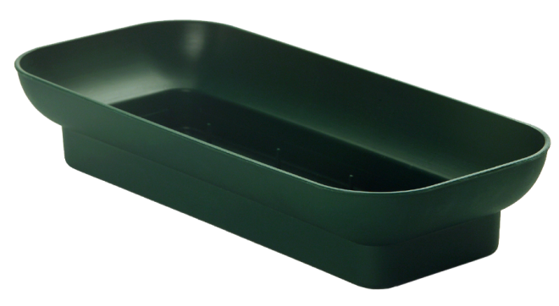
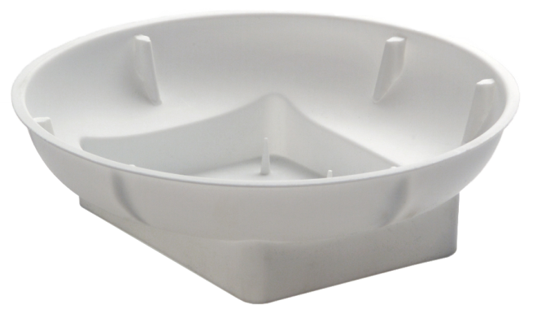
Floral Containers
Have multiple prongs inside the dish to hold floral foam securely in place
Will have a generous water reservoir to keep foam saturated
Are very sturdy and ideal for everyday, holidays, centerpieces, parties and sympathy arrangement use

Slide 58
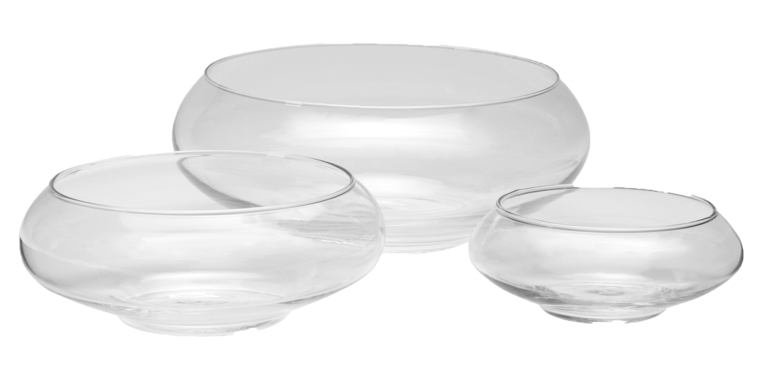
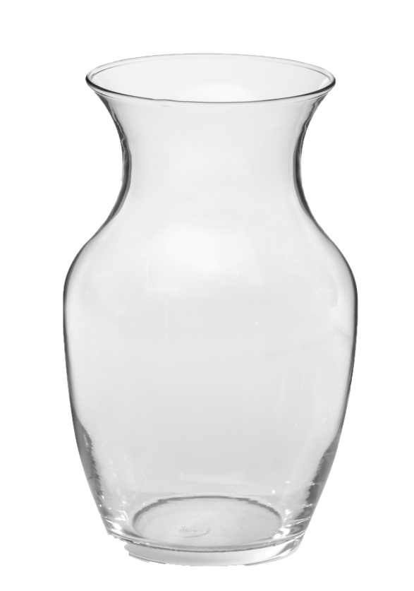
Glass Vases
Are the most requested vases
Have clean lines which make them appropriate for any occasion

Slide 59
Return to
Main Menu

Slide 60
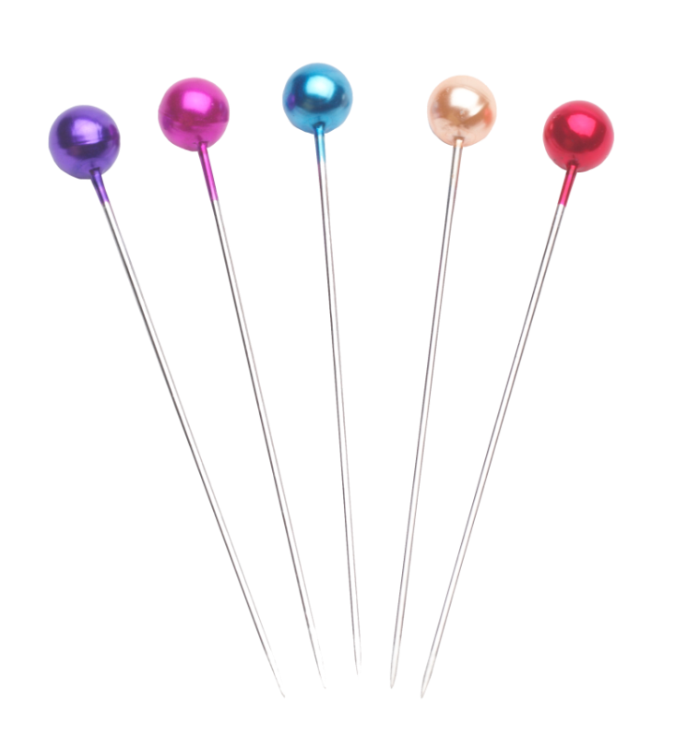
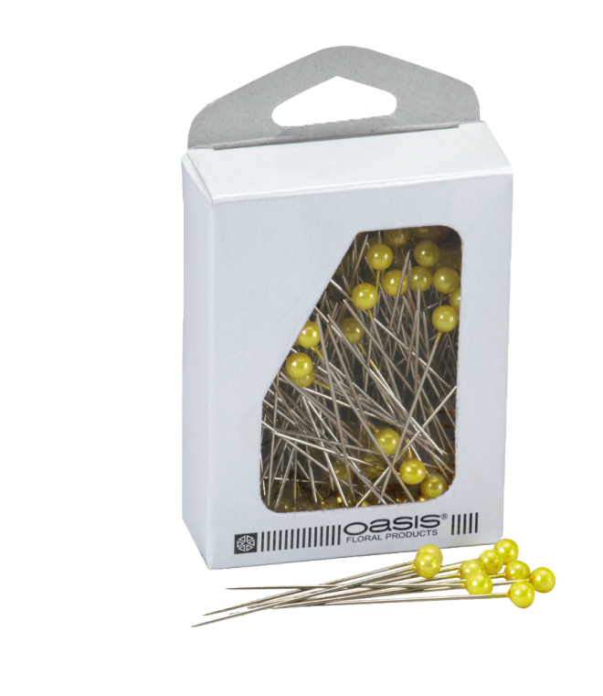
Corsage & Boutonniere Accessories
Include boutonniere and corsage pins, bags and pearl pins
Are available in many different styles and colors

Slide 61
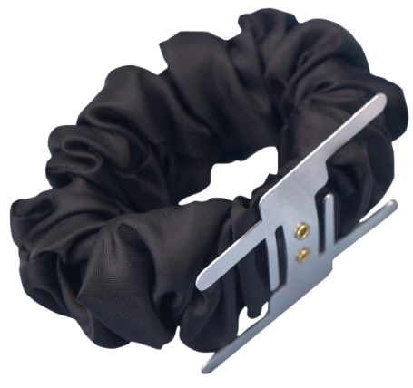
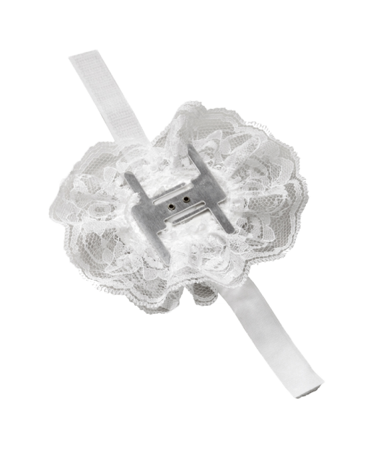
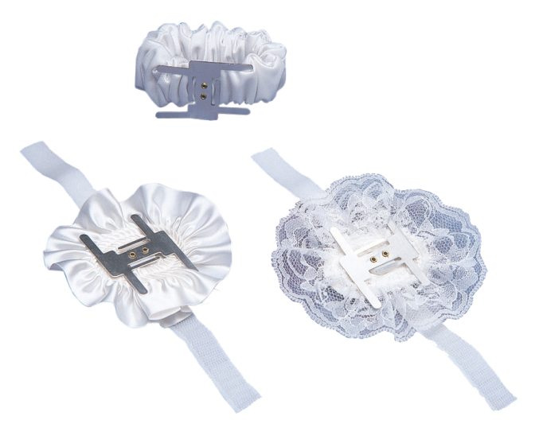
Corsage Accessories
Include corsage wristbands for added convenience

Slide 62
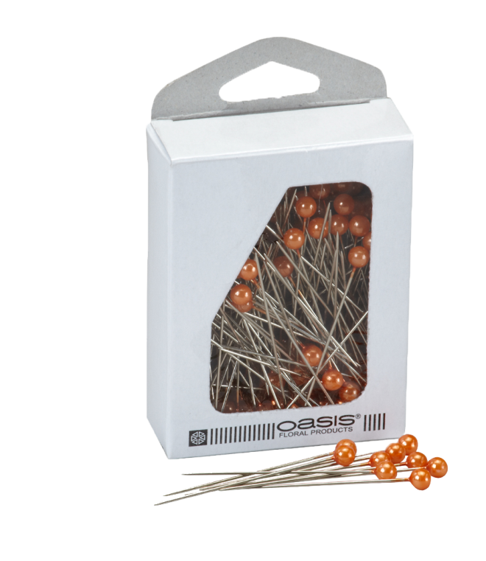
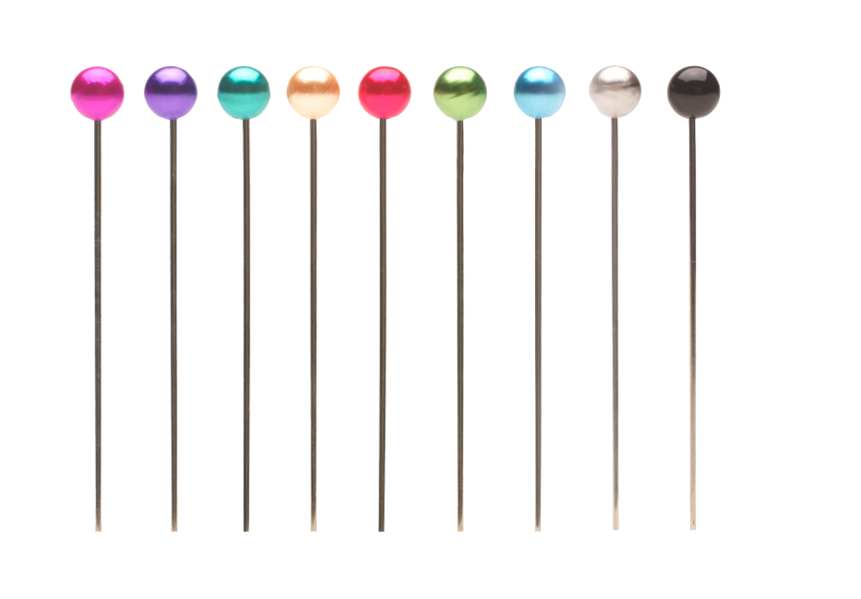
Corsage Accessories
Such as pearl pins, are used to dress up boutonnieres and corsages and come in many different styles and colors

Slide 63
Resources
Oasis Floral Products http://sona.oasisfloral.com

Slide 64
Acknowledgements
Production Coordinator
Mai Lee Holmes
Project Coordinator
Olivia Mitchell
Graphics Designer
Daniel Johnson
Technical Writer
Jessica Odom
Production Manager
Maggie Bigham
Executive Producers
Gordon W. Davis
Jeff Lansdell
© MMXII
CEV Multimedia, Ltd.

